Slide 1

"Pizza Sales Analysis made by SQL."
Hello, My name is priyanka and in this project i have utilise sql query to solve question that related to pizza sales

Slide 2


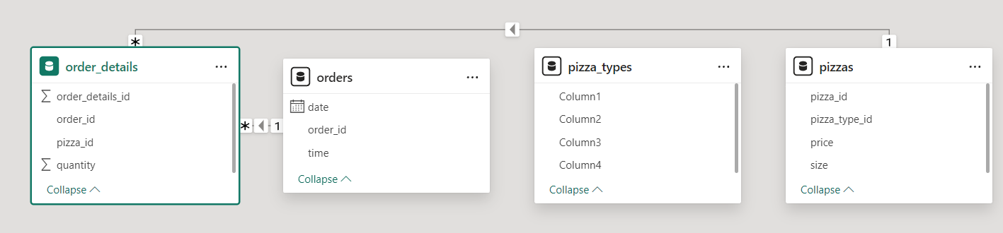
Pizza Sales Table Data

Slide 3


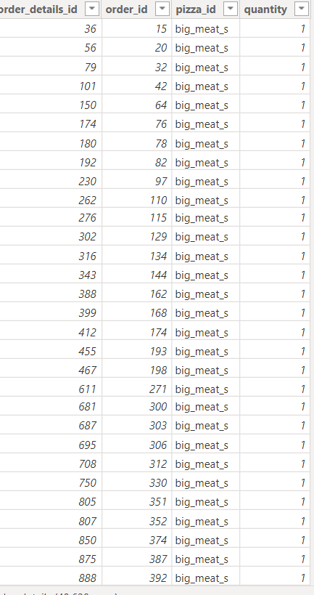
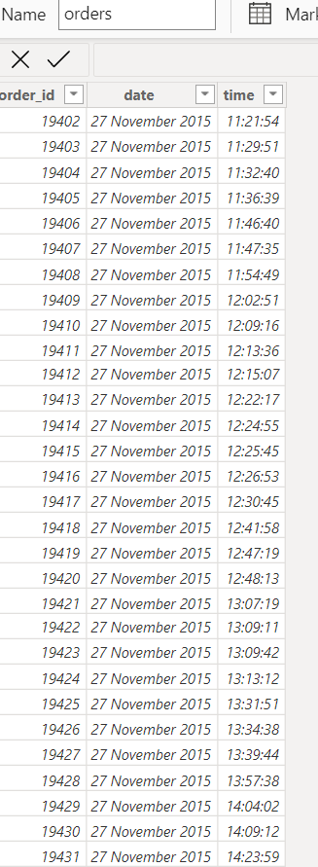
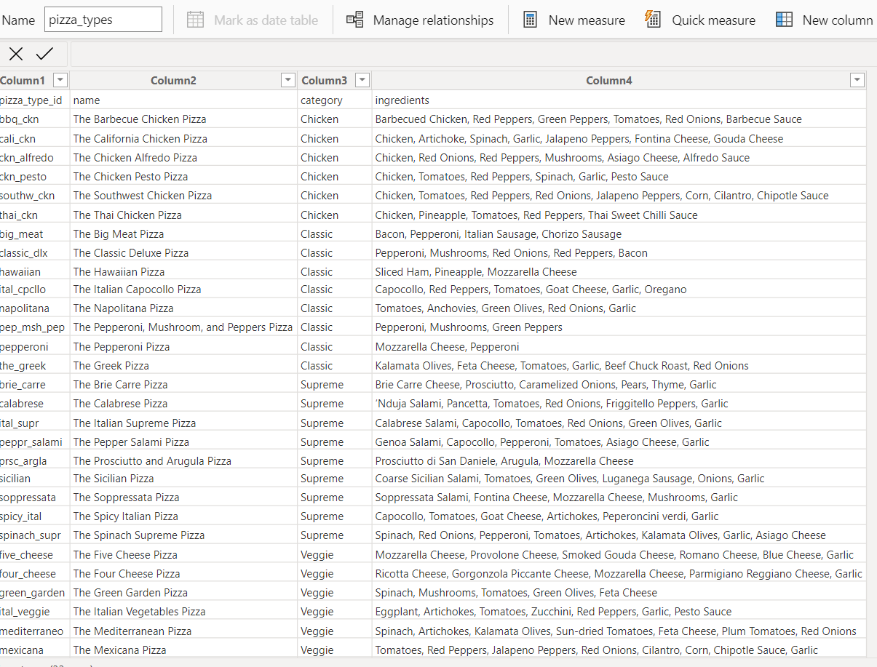
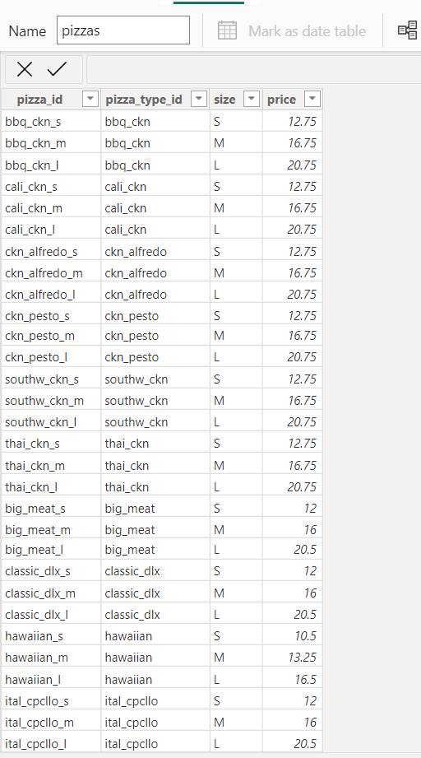

Data Structure

Slide 4
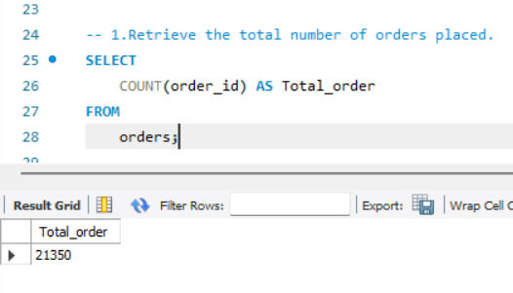
Retrieve the total number of orders placed.

Slide 5
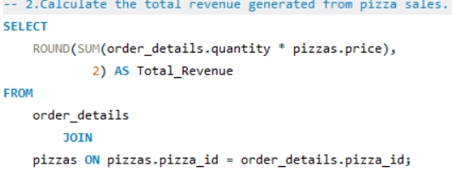
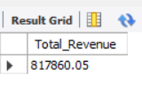
Calculate the total revenue generated from pizza sales.

Slide 6

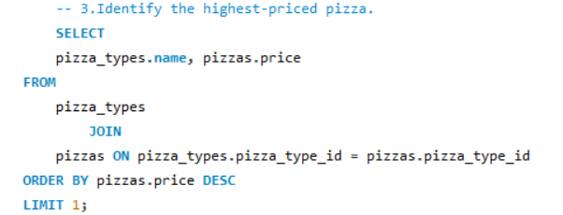

Identify the highest-priced pizza.

Slide 7

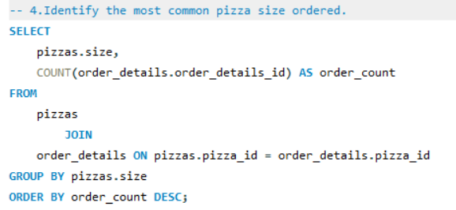
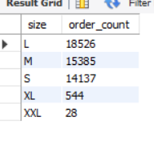
Identify the most common pizza size ordered.

Slide 8
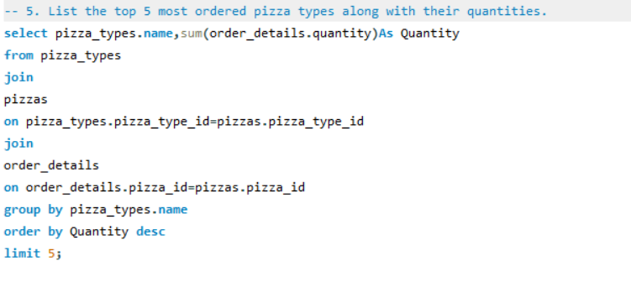
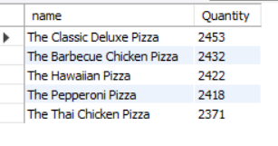
List the top 5 most ordered pizza types along with their quantities.

Slide 9

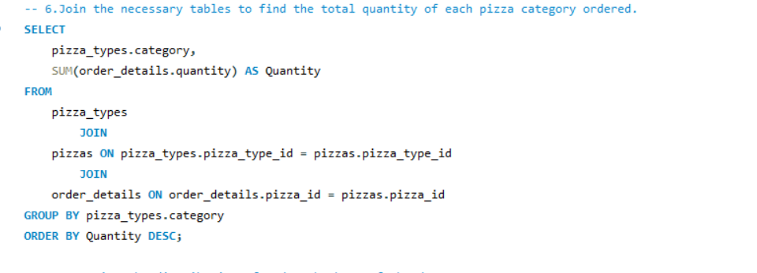
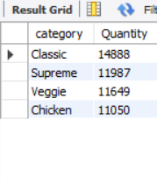
Join the necessary tables to find the total quantity of each pizza category ordered.

Slide 10

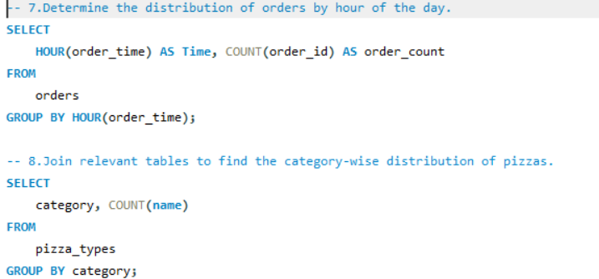
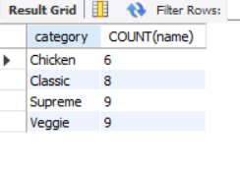
Determine the distribution of orders by hour of the day.

Slide 11

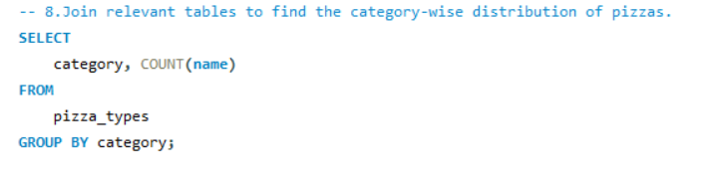

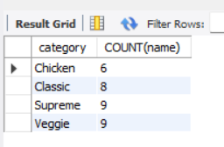
Join relevant tables to find the category-wise distribution of pizzas.

Slide 12
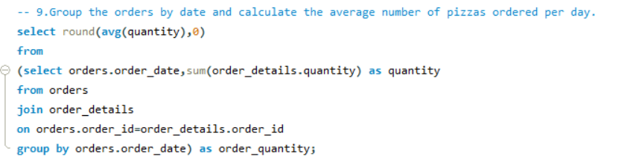
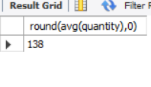
Group the orders by date and calculate the average number of pizzas ordered per day.

Slide 13
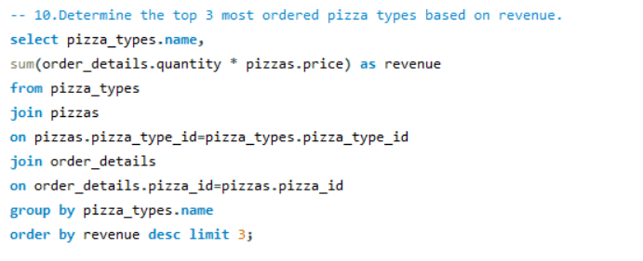
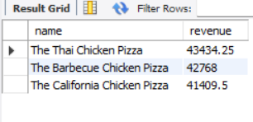
Determine the top 3 most ordered pizza types based on revenue.

Slide 14
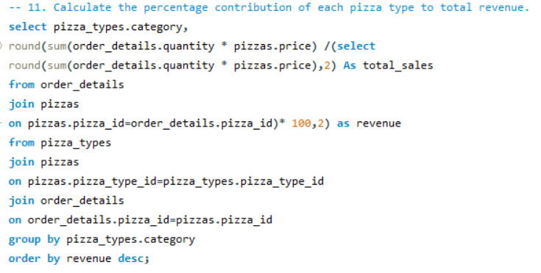
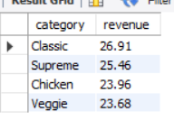
Calculate the percentage contribution of each pizza type to total revenue.

Slide 15
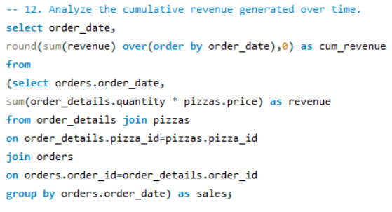
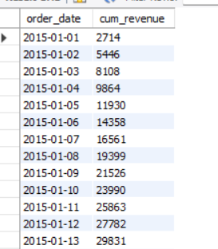
Analyze the cumulative revenue generated over time.

Slide 16
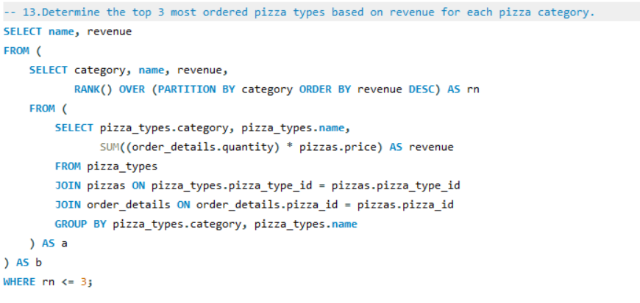
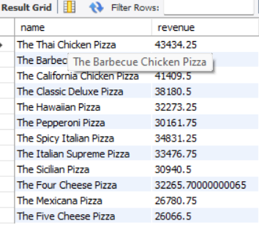
Determine the top 3 most ordered pizza types based on revenue for each pizza category.

Slide 17

Conclusion
Quantifies the overall demand for pizzas within the dataset.
Highlights the financial performance of the pizza sales.
Illustrates the price range within the menu.
Insights into customer preferences regarding pizza size.
Highlights popular pizza choices among customers.
Understanding the distribution of pizza categories.
Analyzing peak hours of demand for pizzas.
Understanding which pizza categories are more popular.
Identifying daily consumption patterns
Understanding the revenue distribution among pizza types.

Slide 18
Thank You!

